Slide 1
TEI in Arabic
Cairo Urban News
https://github.com/Project-Cairo-Urban-News/CairoUrbanNews
Hugh Cayless, @hcayless, 2020-12-08

Slide 2
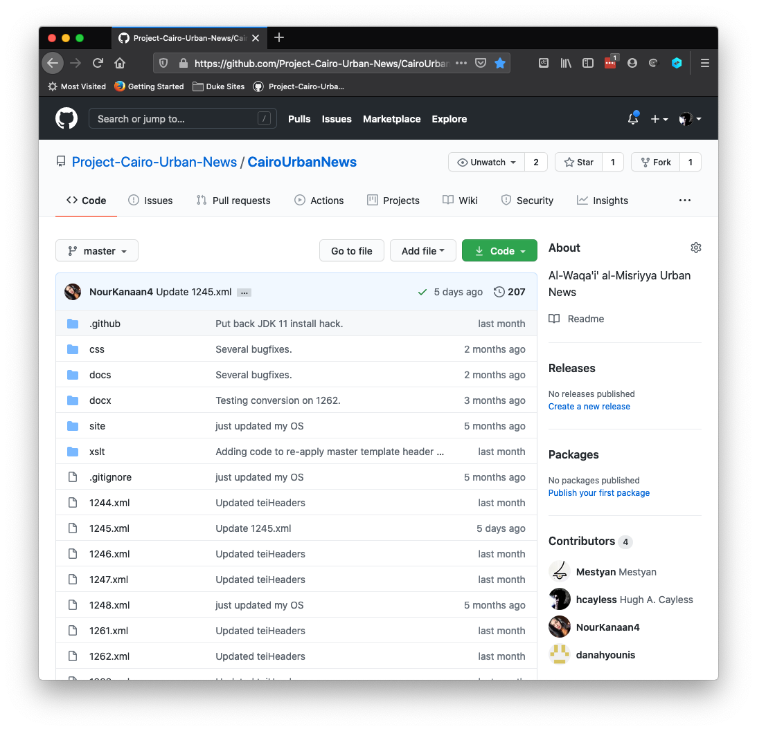
Cairo Urban News on GitHub
Automated Workflows
Word to TEI conversion
Maintain consistency with document template
Automatic preview on GitHub Pages
Working with Arabic in TEI

Slide 3
Word to TEI
Students collate and edit Word documents used to transcribe news articles.
When the Word docs are added to the GitHub repo in the docx/ folder, a GitHub Action is triggered.
The Action converts the Word document into a TEI file using the Cairo Urban News template and commits the result.
Word
Action
Template
Word
XSLT
TEI

Slide 4
Update from Template
The template file contains the standard TEI Header and structure used in the project.
If this file is updated, the other project file headers need to be updated to match it.
So when a change to the template is pushed, the existing TEI files are re-processed to put their content into the updated template.
Template
Action
Template
TEI files
XSLT
TEI

Slide 5
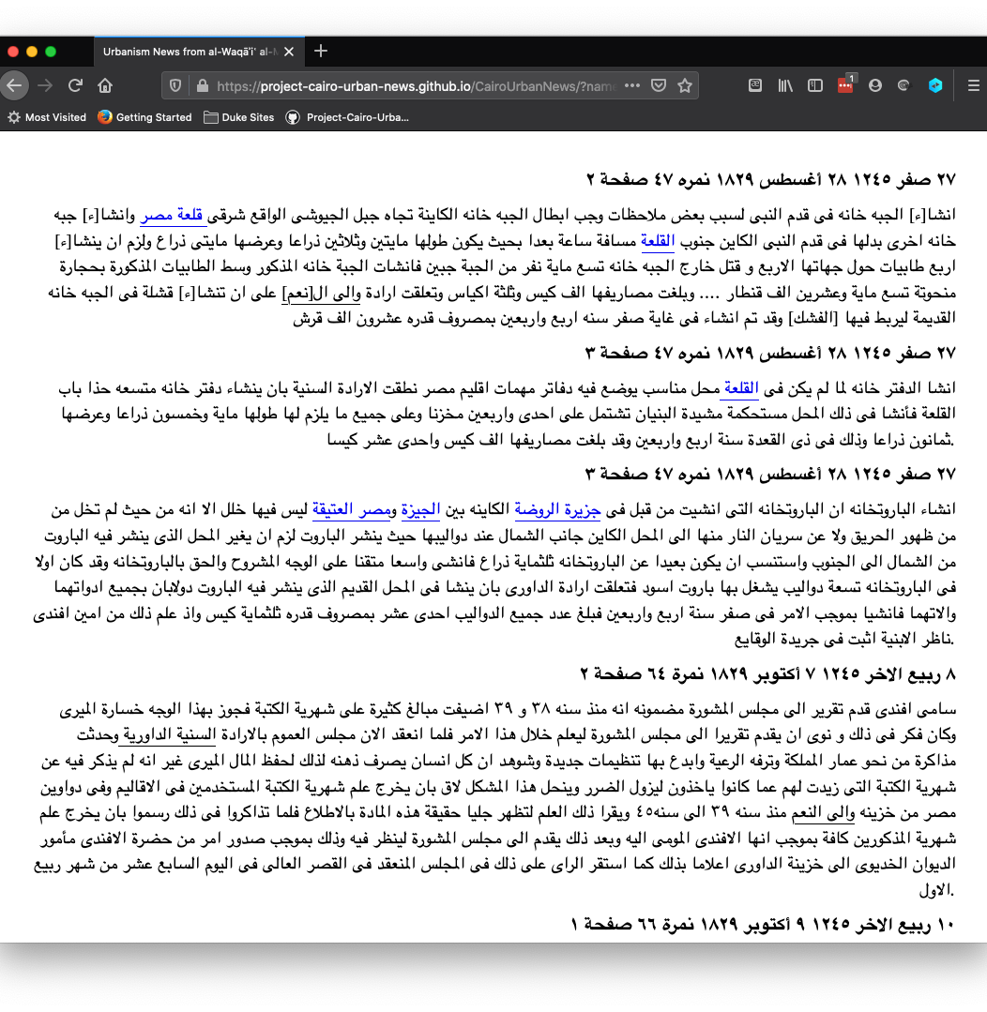
Automatic Preview
A preview of the article files is hosted on github.io based on the docs/ folder in the repo.
The preview uses CETEIcean to render the TEI sources into a simple HTML view.
https://project-cairo-urban-news.github.io/CairoUrbanNews/

Slide 6
Working with Arabic in TEI
We use the oXygen XML editor, which has built-in TEI support
There are problems working in the traditional text view, so we use Author view, with a custom CSS stylesheet to manage the display.
We are developing a custom schema.

Slide 7
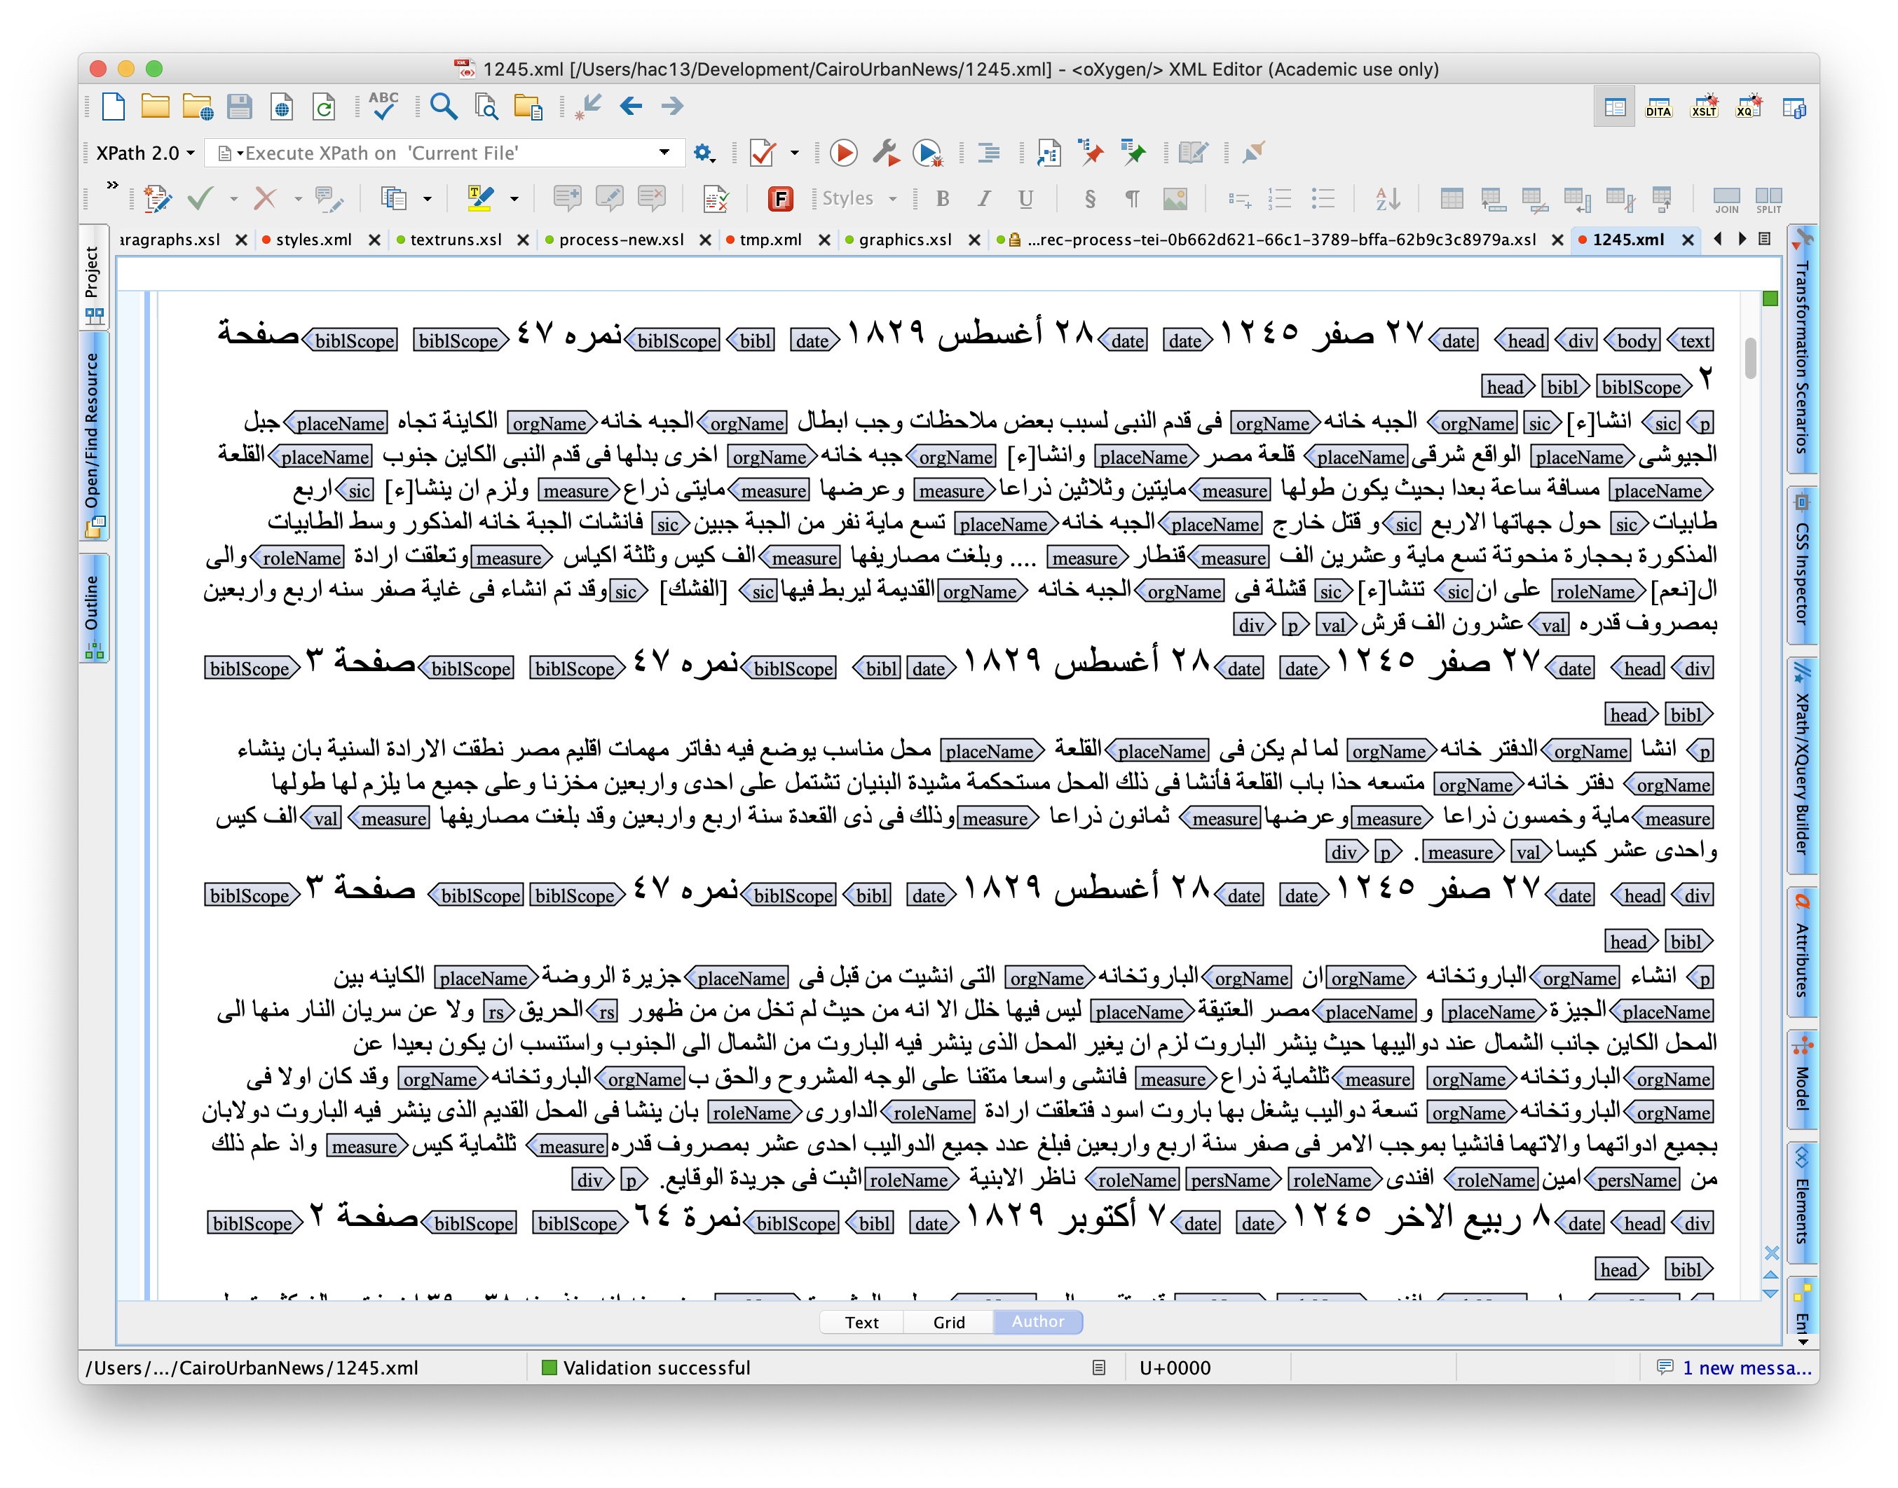
oXygen Author Mode

Slide 8



Slide 9
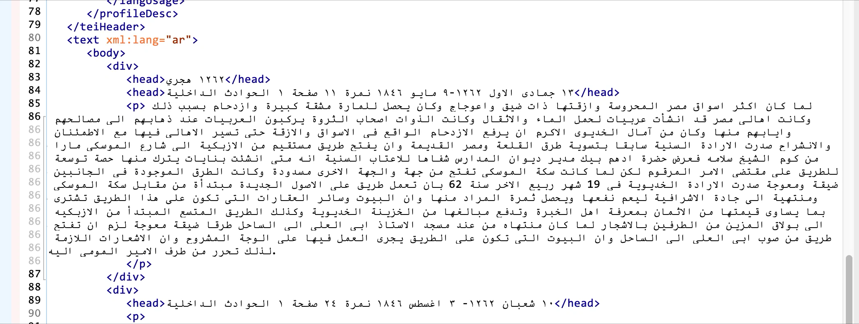
Editing TEI directly in “text mode” is hard

Slide 10


The Problem
What’s going on?
We went from this:
To this:
This is perfectly correct, as far as it goes. It’s following the Unicode Bidirectional Algorithm (https://unicode.org/reports/tr9/).

Slide 11
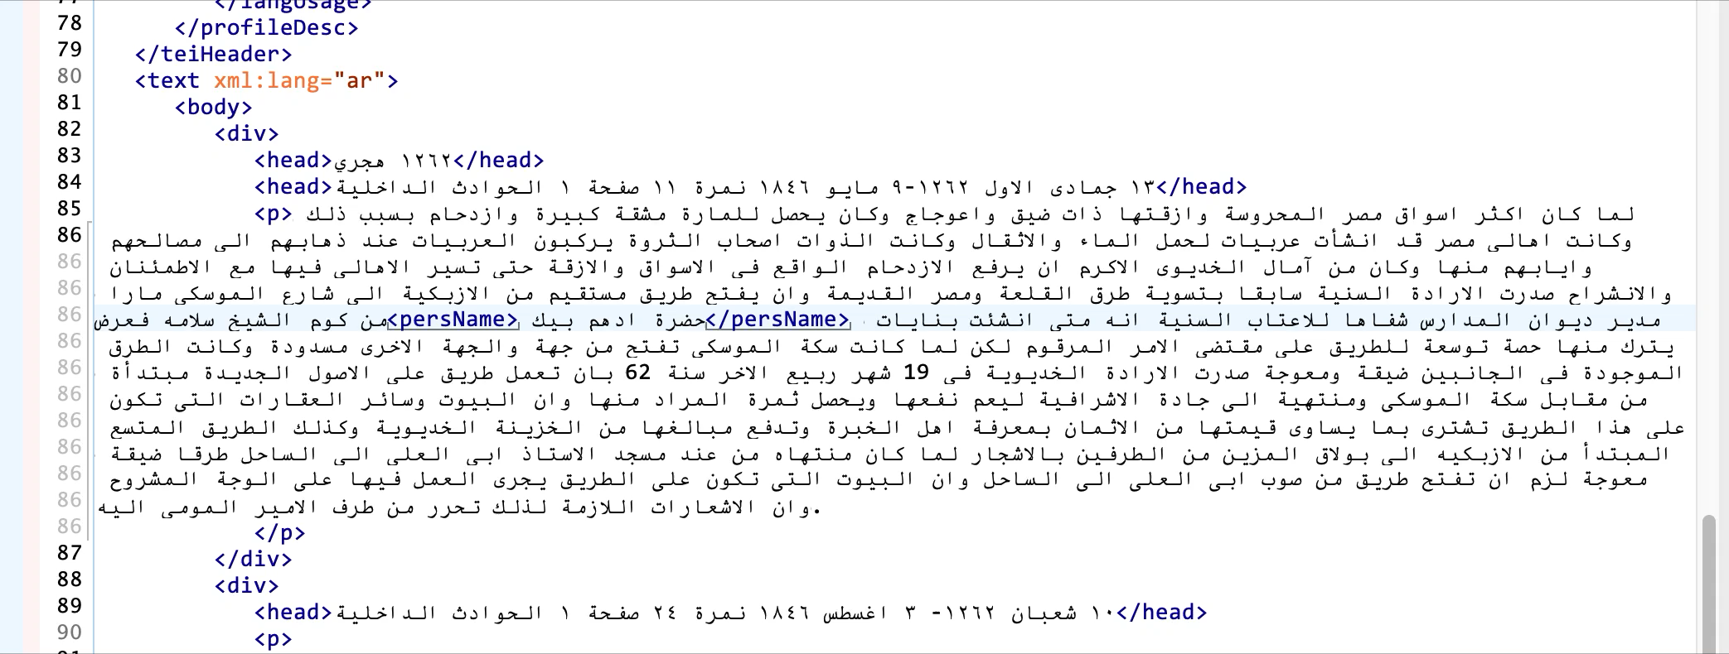
The Solution
Change the element names to Arabic
oXygen does not like this at all!

Slide 12
The Solution
TEI lets you rename elements
TEI schemas and documentation are defined using a (TEI based) language called ODD (for One Document Does it all). In other words, TEI is defined in TEI.
ODD allows you to provide alternate names for elements and attributes, so we can take basic TEI and rename things in Arabic.
Once you have a defined ODD, you can use it to generate schemas that will validate your TEI documents, provide context-specific help, etc.

Slide 13
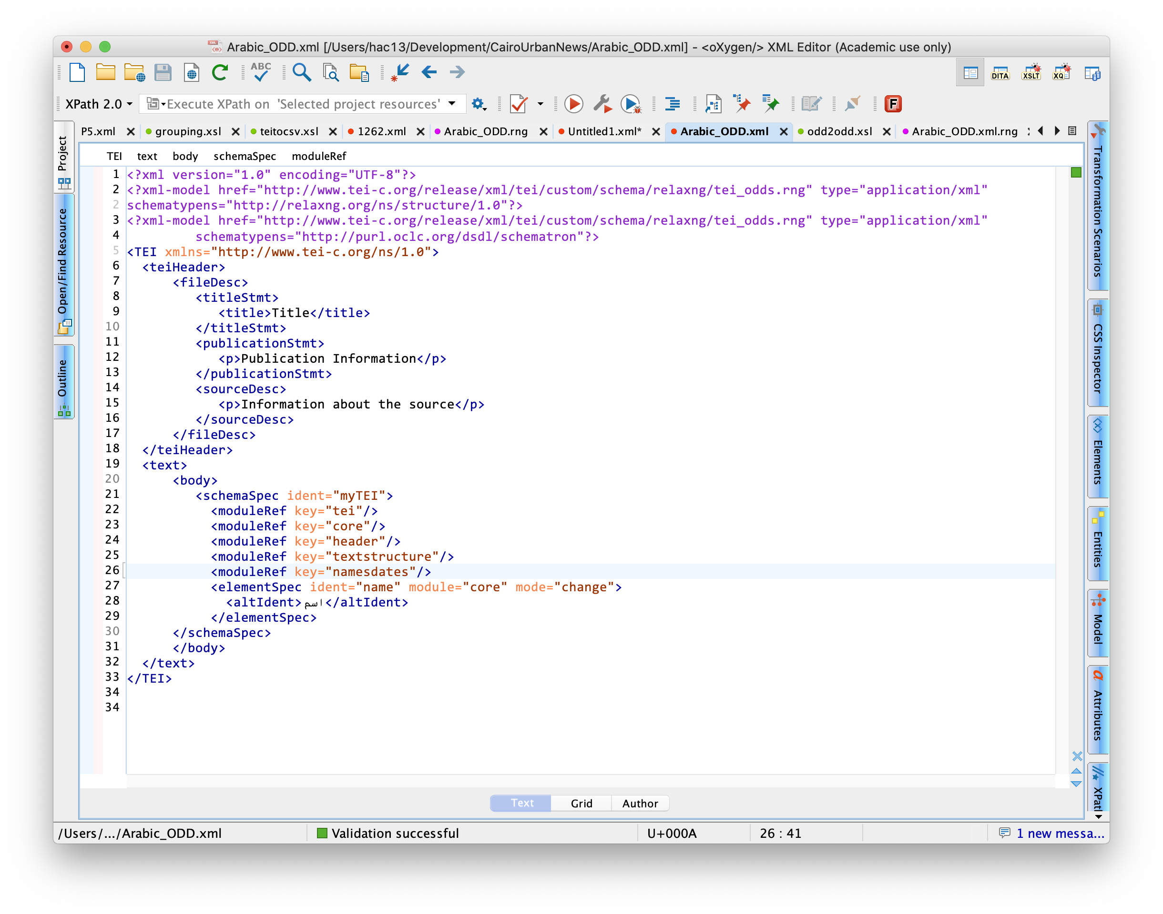
<altIdent>اسم</altIdent>

Slide 14
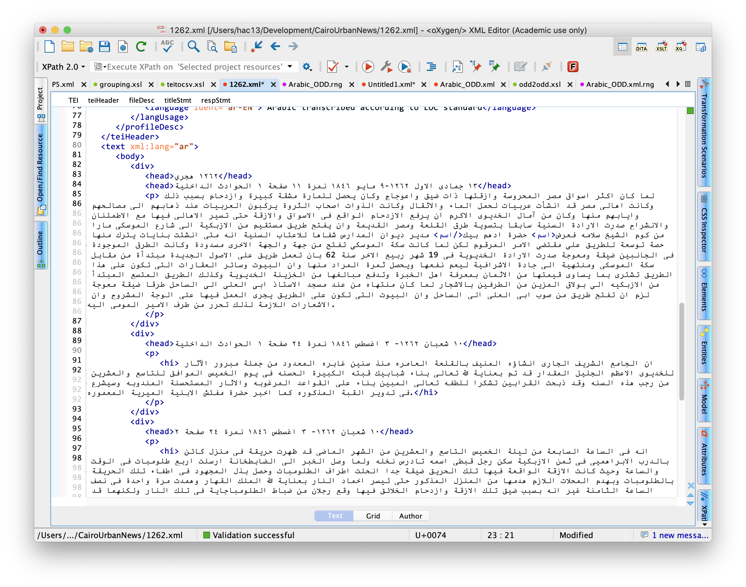

Document is valid!

